Slide 1
HR Analytics Dashboard
Tableau Presentation

Slide 2
Introduction
This Tableau dashboard offers comprehensive insights into employee attrition and satisfaction through interactive and detailed visualizations. By leveraging gender, education, and age data, it enables informed decision-making to improve retention and employee engagement, supporting overall organizational health and growth.

Slide 3
TABLE OF CONTENTS
01
02
Dashboard Overview
Data for Analysis
03
04
Employee attrition rate section
Job satisfaction section
06
Attrition by gender section
05
Attrition by education section

Slide 4
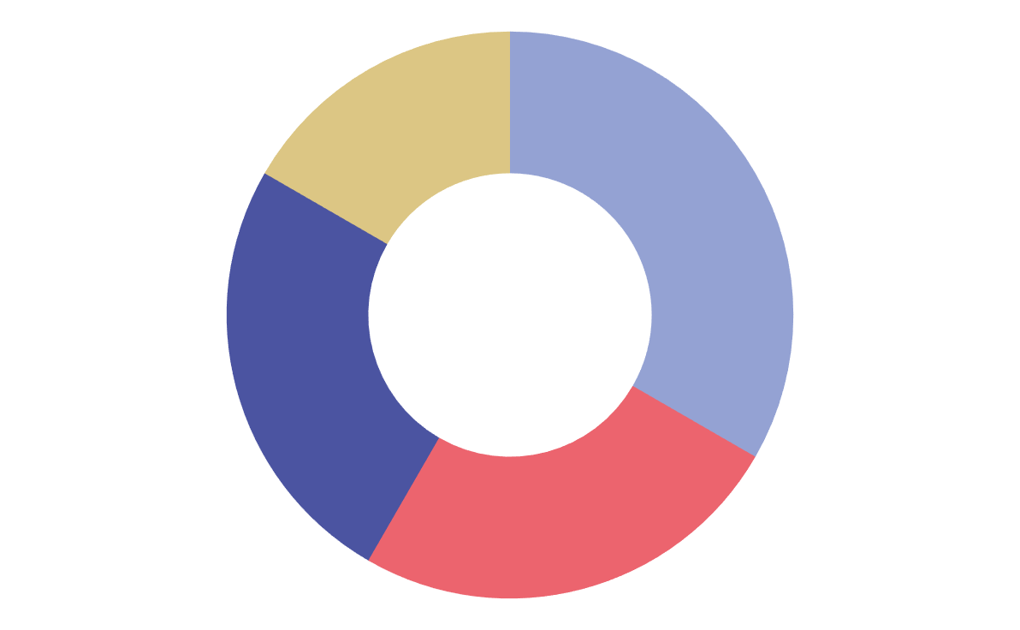
01
Dashboard Overview
Attrition rates by department, education, gender, and age
Job satisfaction by role
Employee demographics (age, gender, education)
Key Metrics
Department distribution

Slide 5
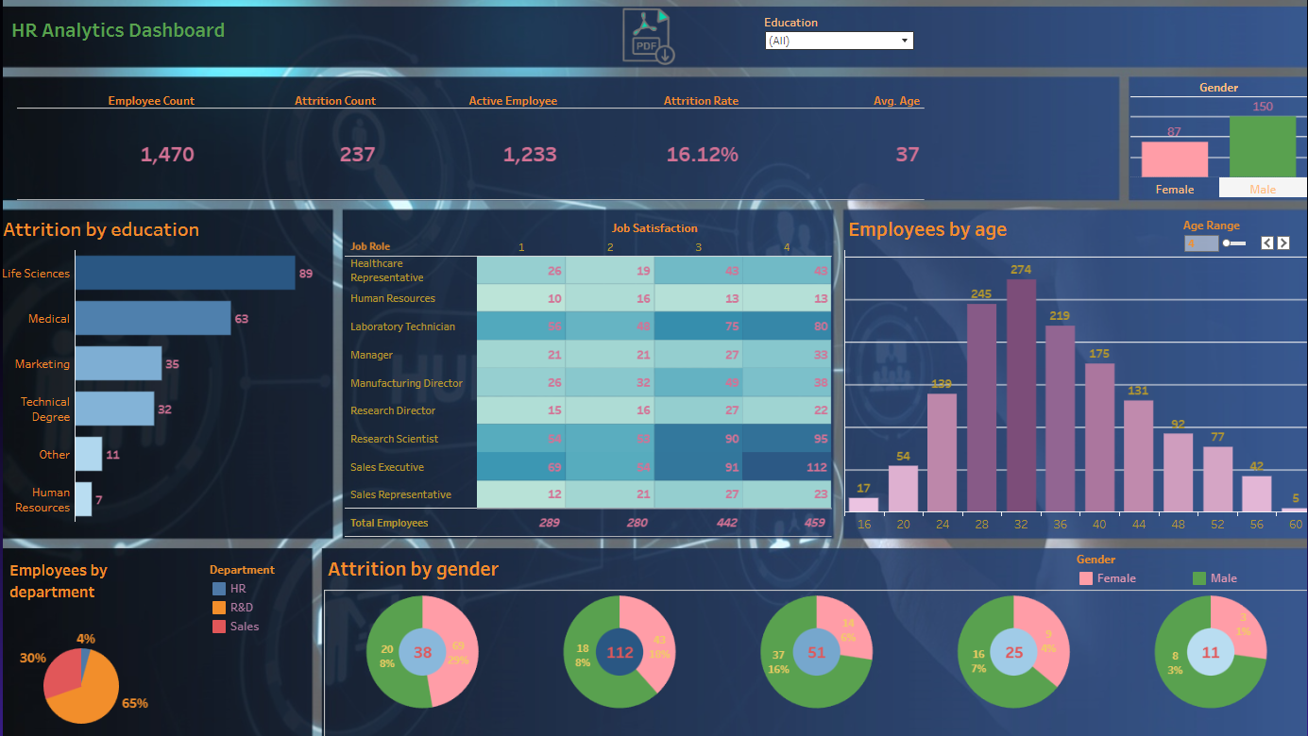
Education filter
PDF Export
Age range parameter
Gender distribution indicator

Slide 6
02
Data for Analysis

Slide 7
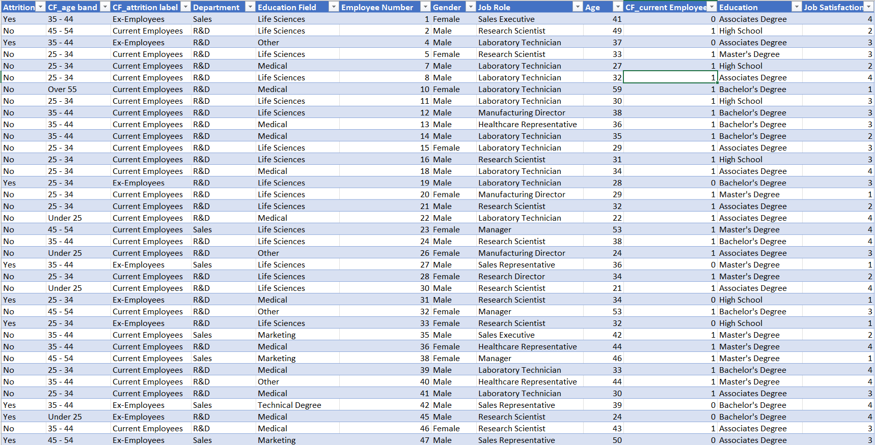
Data for Analysis

Slide 8
03
Employee attrition rate section
Attrition rate
Employees by age

Slide 9
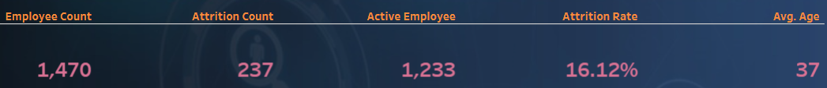
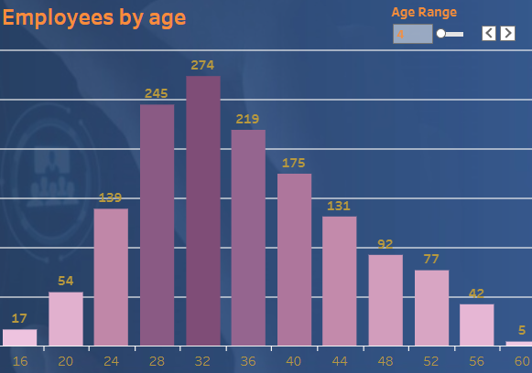
Employee attrition rate section
According to the summary table Employee Attrition Rate is 16%. 237 employees became inactive out of 1,470 total
Employee Average Age is 37 years old
Age range parameter control allows defining the gap between displayed employee ages
Employees by age graph shows how many employees the company has in the defined age range. Most of them (274) are about 32 years old

Slide 10
04
Job satisfaction section
Employees by department
Job satisfaction

Slide 11
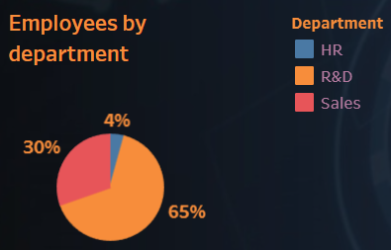
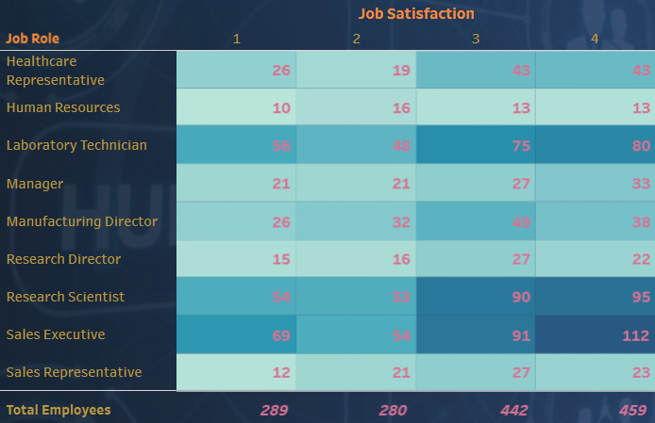
Job satisfaction section
Job satisfaction table tries to uncover trends on how well people with different job roles are motivated at work
Most of Sales Executives (112) have the best job satisfaction level (4)
Employees by department pie chart shows the proportion of people working in the specific department. Most of employees are in R & D group (65%)

Slide 12
05
Attrition by education section

Slide 13
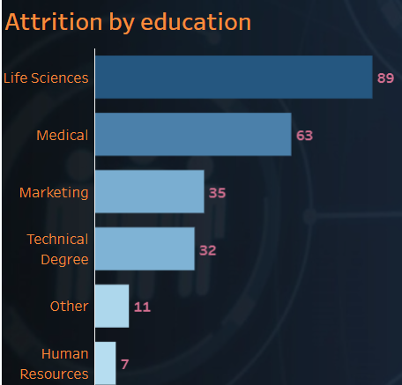
Attrition by education section
This graph breaks down attrition rates by employees’ education levels, revealing how turnover varies across academic backgrounds
Most of separated employees (89) had Life Sciences background
Insights from this analysis assist HR in tailoring engagement and development programs to different employee groups based on their educational profile

Slide 14
06
Attrition by gender section
Gender
Attrition by gender

Slide 15
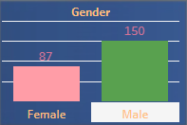
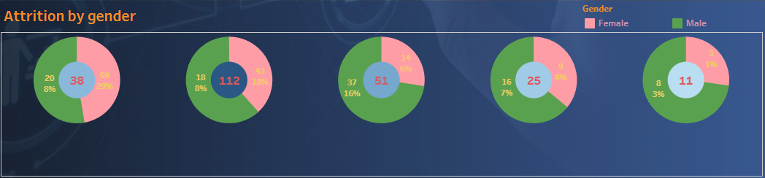





Attrition by gender section
Bar chart shows employee demographic breakdown by gender
More males (150) are employed by the company than females (87)
Donut charts compare employee attrition rates between genders for different age groups
Most of the separated employees (112) were in the 2nd age group between 25-34 years old
Most of the separated females (69) were under 25 years old. Most separated males (37) were between 35-44
Understanding these trends supports targeted retention strategies and promotes workplace equity

Slide 16


Website
https://koval-vlad-portfolio.vercel.app/
Profile
https://www.linkedin.com/in/vlad-koval-614976a4/
Vlad Koval
Projects https://github.com/koval-vlad
Email vkoval@gmail.com
Thank you!

